Slide 1



Travio Travel Planner
Provide the Best Comfort and Service for Your Trip

Slide 2


Our Agenda
1. Research and Planning
2. Prepare for the Trip
3. Choose the Destination:
4. Stay Safe and Respect the Environment
5. Document and Share Memories.

Slide 3

Problem Statement
To provide you with a relevant problem statement for our project, I would need more information about the specific nature and objectives of our project.
It's important to note that these problem statement may vary depending on the specific Himalayan hill Travelling.
Limited Accessibility, Weather and Climate, Altitude-related Issues, Limited Infrastructure, Seasonal Crowds, Environmental Impact , Higher Cost of Living, Limited Accessibility

Slide 4

Project Overview
We want to provide information about safe traveling
in the Himalayan hills, specifically in places
like Kedarnath, Darjeeling, Valley of Flowers,
Manali, Ladakh, and Kashmir."

Slide 5
Who Are The End Users?
Yes, people of all kinds can use websites.
These websites are user-friendly and can be easily understood by the general public.
These websites typically provide simple interfaces and options

Slide 6
Solution And It’s Value Preposition
Unusual weather conditions such as cold, heat, snow, and rain.
Altitude sickness due to lack of oxygen at high altitudes.
3. Symptoms like low blood pressure, dizziness, or headaches.
4. It is important to carry necessary supplies like food, water,
5. There is a risk of natural disasters like earthquakes, rain, landslides, or avalanches.
6. There may be transportation issues like car or train breakdowns, which may cause delays.
7. Before embarking on a Himalayan journey, it is important to prepare well.

Slide 7
Wow Moment
It is a excellent tour with Himalayan traveling .
Yes, a user-friendly website can be enjoyed by people of all kinds and they
can explore new places through it. A user-friendly website is designed to be easy
to navigate and understand, making it accessible to a wide range of users.
Whether someone is tech they can still enjoy using a website
that is provides a seamless experience. Additionally, a well-designed
website can showcase various destinations and attractions, allowing users to discover and
explore new places.

Slide 8
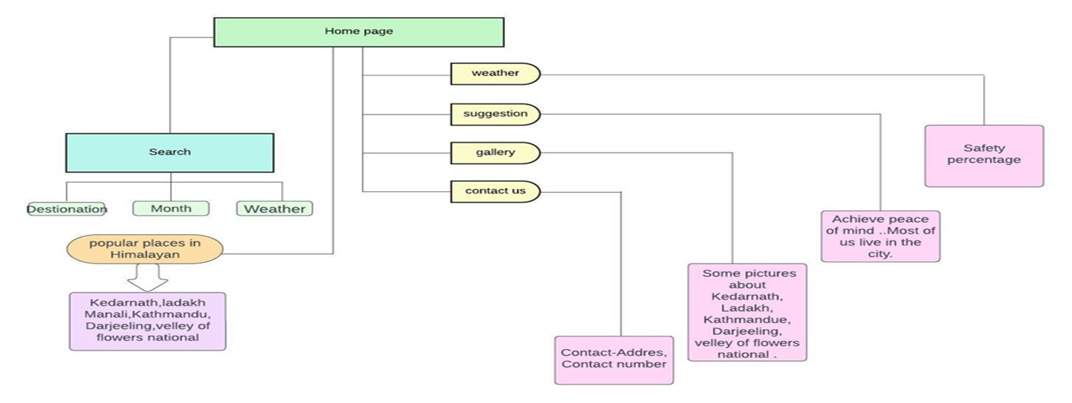
Modelling
HOME PAGE
WEATHER
SUGGESTION
ABOUT US
CONTACT US

Slide 9

Result
On this project, our team has put in a
lot of hard work,
and we hope it is appreciated by you all.
We aim for it to be
useful and helpful for you as well

Slide 10
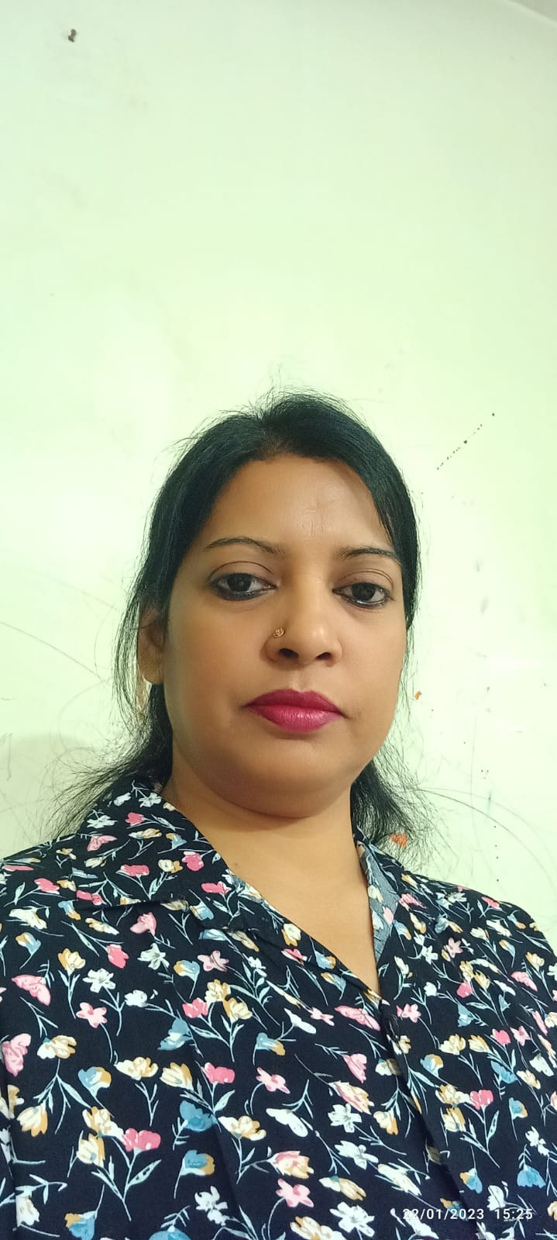
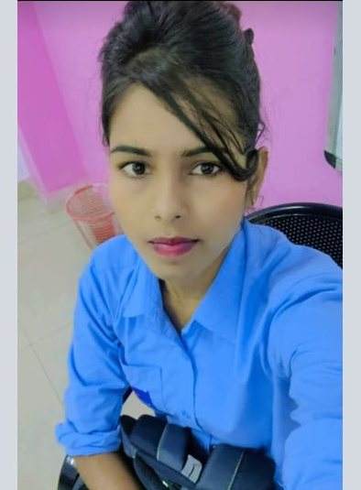
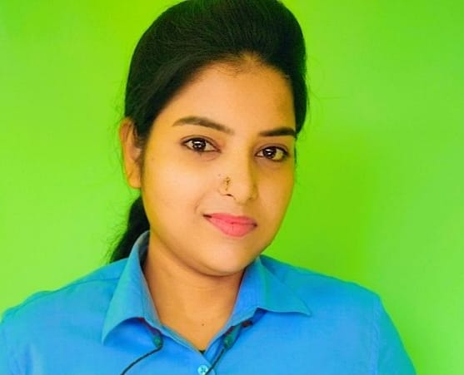
Meet our team
Shikha Kumari
Archana kumari
Roshni Verma
Co-Founder
Co- Founder
Co-Founder

Slide 11

THANK YOU
Thanks for our Teachers and everyone present there in the meeting session.
special thanks My trainers for her ideas and suggestions
Travio Travel
travio@contoso.com
www.contoso.com

